Slide 1
Environmental awareness Automation Monitoring System for Training Dog Kennel
Sumalee chaisit, Hsu-Yang Kung,
Jian-Liang Pan, Yan-Hua Chen
National Pingtung University of Science and Technology, Pingtung, Taiwan
2013 4th International Conference on Agriculture and Animal Science
Phuket, Thailand
23-24 November, 2013

Slide 2
Content
Introduction & background
System Frame work and Design
System Implementation
Conclusions

Slide 3
Introduction
Environmental Issue
Training Dog Security and cost
Heterogeneous Technology

Slide 4
Environmental Issues
Environmental awareness is currently significant caring in all industrial sectors, particularly in the animal industries.
Taiwan, abruptly change in temperature cause heavy storm, Typhoon & frequency earth quake
[Central Weather Bureau, http://www.cwb.gov.tw/eng/index.htm]
Animals are directly affected by environmental conditions and climate changes.

Slide 5
Training Dog Security and cost
Working dog training is high cost high quality treated in its health, husbandry and training program.
Succeeded training dog was 56% approximately.
39% had been passed during a training program for 4 months standard program.
Health and temperament are key factors to be successful in training dog program.
Housing dog environment is related to the Health and temperament.

Slide 6
NPUST Working dog training Kennel
Providing :
  Training of professional trainers
  Working dog training courses and techniques
  Kenneling techniques
  Disable services
  Breeding center and vet care center
  Including, enhance the efficiency monitoring management systems

Slide 7
How to control the housing dog environment?
Can be secure the animal welfare.
To be automation capture the environmental data.
Simple transfer the analyzed information
Monitor the changing of the kennel environment and the dog health care

Slide 8
Heterogeneous Technology
Because, the climate extremely change is difficult control in a safe time range, so automatically technologies are considered.
Climate Sensing System
RFID System
Data mining systems

Slide 9
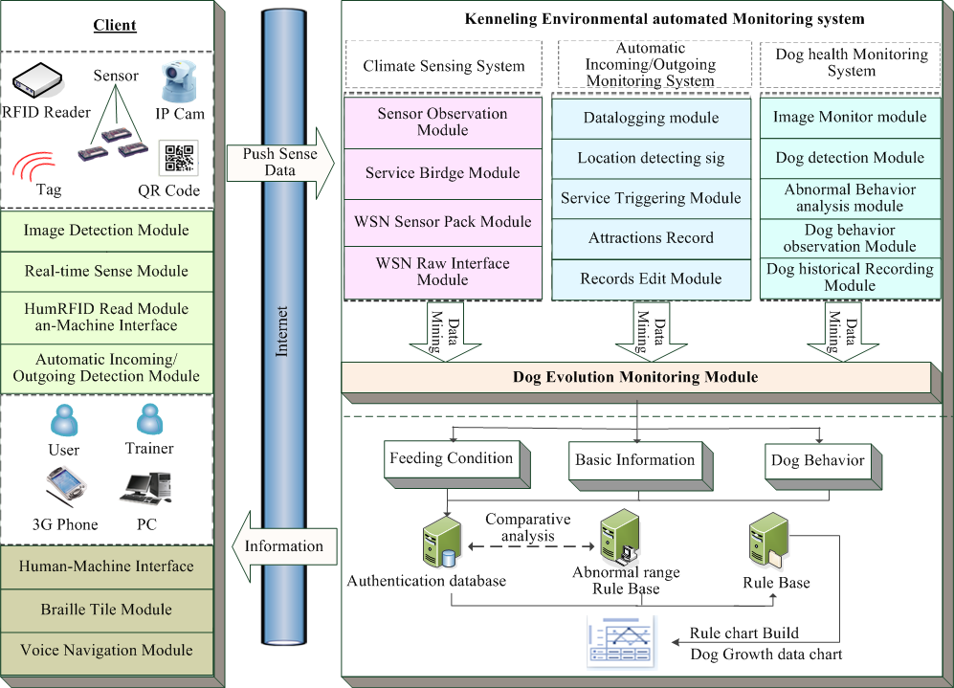
System Framework and Design

Slide 10
System Implementation
Climate sensing system
Incoming/Outgoing control system
Health care monitoring system

Slide 11
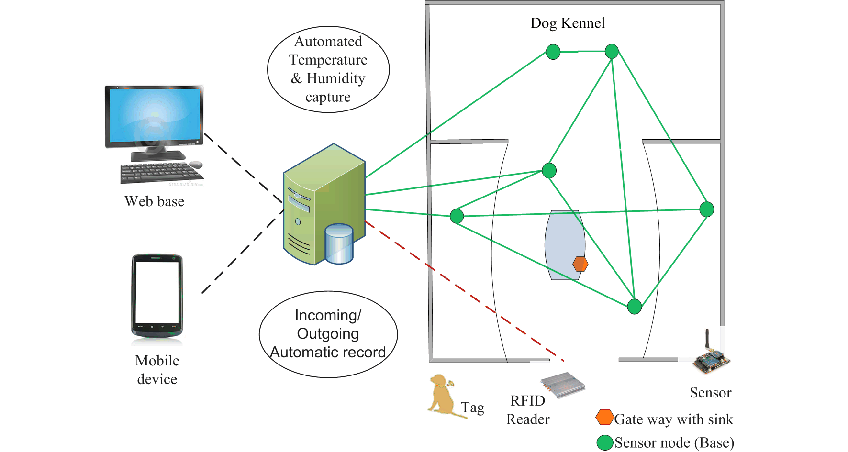
Kennel environmental sensing system

Slide 12
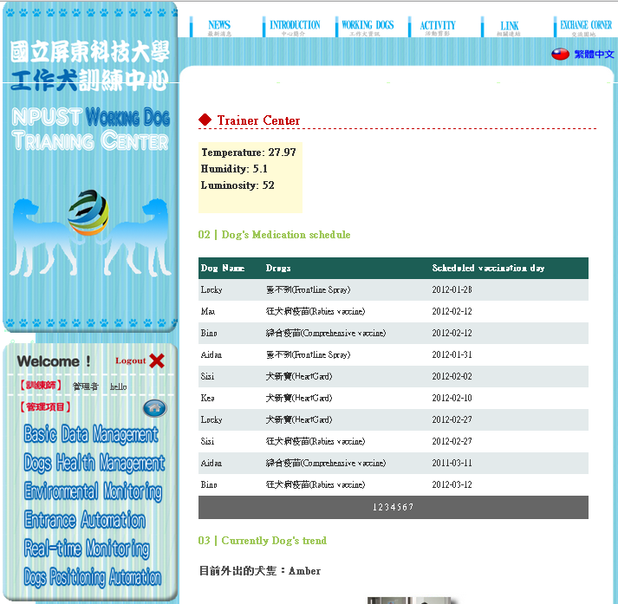
Automation Environmental Data Capturing

Slide 13
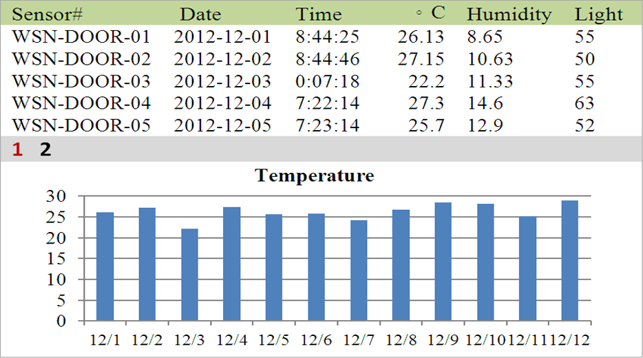
Environmental Data Monitor

Slide 14
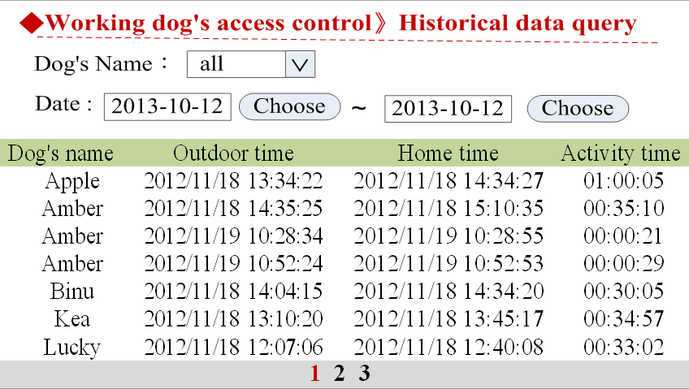
Incoming/Outgoing monitoring system

Slide 15
Dog health monitoring system

Slide 16
Dog Vaccine records

Slide 17
Conclusions
Implemented with a heterogeneous computer communication system,
secure animal health and value added of the successful trained dogs.
The nourishment cost can be recovered from the improvised animal health and training management service delivery to dog owners.
Moreover, the system should be expanded to the automatic tracking dog in other training areas.

Slide 18

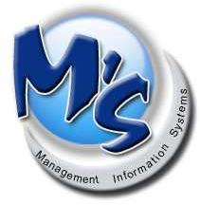



ACKNOWLEDGEMENT
    มหาวิทยาลัยเทคโนโลยีอีสาน
    RMUTI
Rajamangala University
of Technology Isan

